Slide 1
Fraud and Auditing

Slide 2
Certified Fraud Examiner (CFE)
Fraud Prevention & Detection
Academic & Experience
High Moral Character
Pass CFE examination
CPE

Slide 3
Fraud Risk Assessment

Slide 4
Fraud Risk Assessment
Think about what can go wrong
Analytical Reviews
Look for Negative Trends
Look for Extremely High Performance

Slide 5
Common Fraud Schemes

Slide 6
Common Fraud Schemes
Credit Cards
Thief of Cash
Expense Reports
Look for Negative Trends
Refunds

Slide 7
Data Analysis Techiques

Slide 8
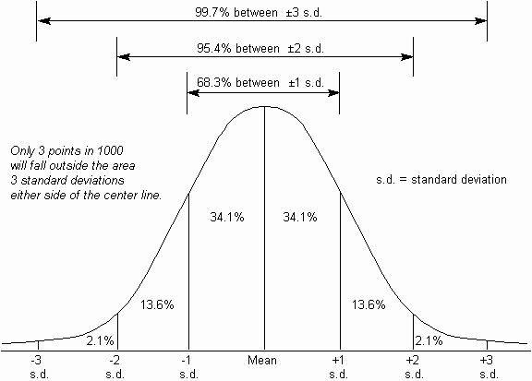
Standard Deviation

Slide 9
Revenue / Expense Trends
Revenue Falling
Expenses Rising

Slide 10
Benford’s Law (?)
IMO, It is NOT a good detection tool

Slide 11
Benford’s Questions
How much variance does it take for you to be 80% sure that you have a Fraud?
Why does Benford’s appear to work?

Slide 12
Benford’s Distribution -Same Org, Different Time (by 6 months)
Chart A
Chart 1

Slide 13
Big Data / Deep Analysis
Effective Now
More Effective in the Future

Slide 14
Questions? Preguntas? Fragen?

